Slide 1
Choosing an appropriate method for finding lengths of a triangle
Trigonometry

Slide 2
How our teaching resources are designed for the classroom

Slide 3
I can choose the appropriate method to find the missing side in a right-angled triangle.

Slide 4
The trigonometric ratios are ratios between each pair of lengths in a right-angled triangle:
sin(θ°) = opposite cos(θ°) = adjacent tan(θ°) = opposite
hypotenuse hypotenuse adjacent

Slide 5

Choosing an appropriate method for finding lengths of a triangle
Trigonometry or not
Practical uses of trigonometry

Slide 6



Trigonometry or not
Alex and Aisha are discussing how they would find the perimeter of this triangle.
15 cm
So we need to calculate the third edge first.
The perimeter is the sum of the edges.
53.1°
9 cm
Aisha
Alex

Slide 7
Trigonometry or not
Alex and Aisha are discussing how they would find the perimeter of this triangle.
Let the third edge be x, which is opposite the given angle. I know the length of the hypotenuse so I will use sine.
15 cm
x cm
x = 15 × sin(53.1°) = 12.0 cm
53.1°
Perimeter = 15 + 9 + 12 = 36 cm
9 cm
Aisha
Alex

Slide 8
Trigonometry or not
Alex and Aisha are discussing how they would find the perimeter of this triangle.
I would use Pythagoras’ theorem to calculate the length of x.
15 cm
15² = 9² + x²
x cm
x² = 15² - 9² = 144
x = 12 cm
53.1°
Perimeter = 15 + 9 + 12 = 36 cm
9 cm
Aisha
Alex

Slide 9

Trigonometry or not
With the given information, you could…
16 cm
…use trigonometry to calculate the other two edge lengths
50°
…use Pythagoras’ Theorem to work out the other two edge lengths
…work out the third angle of the triangle

Slide 10
Trigonometry or not
To calculate the perimeter of this triangle, we need to know the length of the third edge.
Pythagoras’ theorem and the trigonometric functions require right-angled triangles.
16 cm
35°
Where can a right-angled triangle be created?
9 cm
Extending the base edge and dropping a perpendicular line.
16 cm
35°

Slide 11
Trigonometry or not
To calculate the perimeter of this triangle, we need to know the length of the third edge.
Pythagoras’ theorem and the trigonometric functions require right-angled triangles.
16 cm
35°
Now the sine function can be used to calculate the opposite, the vertical height.
9 cm
16 cm
h = 16 × sin(35°) = 9.177…
h cm
35°

Slide 12
Trigonometry or not
To calculate the perimeter of this triangle, we need to know the length of the third edge.
Pythagoras’ theorem and the trigonometric functions require right-angled triangles.
16 cm
9.17… cm
35°
Pythagoras’ theorem, the cosine function or the tangent function can be used to calculate the length of x.
9 cm
16 cm
9.17… cm
x = 16 × cos(35°) = 13.10…
35°
x cm

Slide 13
Trigonometry or not
To calculate the perimeter of this triangle, we need to know the length of the third edge.
Pythagoras’ theorem and the trigonometric functions require right-angled triangles.
16 cm
y cm
9.17… cm
35°
Then Pythagoras’ theorem can be used to calculate the length of the third edge.
9 cm
4.10… cm
y² = 4.10…² + 9.17…²
16 cm
y² = 101.084…
9.17… cm
Perimeter = 10.05 + 16 + 9 = 35.05 cm (2 d.p.)
y = 10.05…
35°
13.10… cm

Slide 14
Trigonometry or not
Which additional lines are most useful to calculate the length of the third edge of the triangle?
8 cm
8 cm
8 cm
21°
5 cm
21°
5 cm
21°
5 cm

Slide 15
Trigonometry or not
This diagram contains three triangles, can you find them?
Focussing on this triangle, we can calculate the length of the third edge by using Pythagoras’ theorem.
x cm
14 cm
65°
a cm
14² = 9² + a²
a² = 14² - 9²
31°
a² = 196 - 81 = 115
9 cm
a = 10.72…

Slide 16
Trigonometry or not
This diagram contains three triangles, can you find them?
Now using this right-angled triangle, the tangent function can be used to calculate the length of the opposite.
x cm
14 cm
65°
10.72… cm
b cm
b = 9 × tan(31°) = 5.41 cm
5.40… cm
31°
Which allows x to be calculated.
9 cm
x = 10.72… - 5.40…
= 5.316 (3 d.p.)

Slide 17
Trigonometry or not
Which of these calculations are valid to find a?
a² = 18² - 14²
18 cm
65°
a cm
a = 18 × cos(65°)
14 cm
a = 18 × sin(25°)
a = 14 ÷ tan(65°)

Slide 18
Trigonometry or not
1) Calculate x in each triangle.
a)
b)
c) The perimeter is 1.2 m
x cm
x cm
x cm
30 cm
30 cm
30°
40 cm
40 cm
40 cm

Slide 19
Trigonometry or not
2) Calculate x in each triangle, giving your answers to 1 decimal place.
a)
b)
x cm
28 cm
x cm
8°
73°
19°
72°
24 cm
12.8 cm

Slide 20
Trigonometry or not
3) Work out the perimeter of this triangle, giving your answer to 1 decimal place.
24 cm
21°
15 cm

Slide 21
Trigonometry or not
1) Calculate x in each triangle.
a)
b)
c) The perimeter is 1.2 m
x cm
x cm
x cm
30 cm
30 cm
30°
40 cm
40 cm
40 cm
40
x² = 40² + 30²
x + 40 + 30 = 120
x =
cos(30°)
x² = 2500
x + 70 = 120
x = 46.2 (1 d.p.)
x = 50
x = 50

Slide 22
Trigonometry or not
2) Calculate x in each triangle, giving your answers to 1 decimal place.
a)
24
y =
x cm
tan(73°)
28 cm
y = 7.33…
8°
73°
y cm
28² = 24² + (x + 7.33…)²
28² - 24² = (x + 7.33…)²
24 cm
208 = (x + 7.33…)²
14.42… = x + 7.33…
7.1 = x (1 d.p.)

Slide 23
Trigonometry or not
2) Calculate x in each triangle, giving your answers to 1 decimal place.
b)
12.8
x =
cos(37°)
x cm
x = 16.0
19°
72°
18°
12.8 cm

Slide 24
Trigonometry or not
3) Work out the perimeter of this triangle, giving your answer to 1 decimal place.
24 cm
Perimeter
= 11.3 + 15 + 24 = 50.3 cm
21°
15 cm
x cm
a cm
a = 15cos(21°)
x² = b² + (24 - a)²
21°
b cm
= 14.00…
x² = 5.37…² + 10²
15 cm
b = 15sin(21°)
x² = 128.822…
= 5.37…
x = 11.3499…

Slide 25
Choosing an appropriate method for finding lengths of a triangle
Trigonometry or not
Practical uses of trigonometry

Slide 26
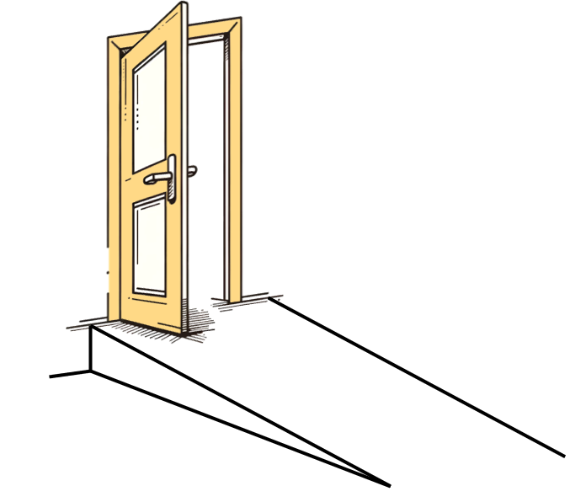
Practical uses of trigonometry
A ramp needs to be built outside a shop for wheelchair access. The incline of the ramp cannot exceed 4.8°. The bottom of the doorway is 34 cm high. How far away from the shop will the start of the ramp need to be?
Assuming the wall of the shop is perpendicular to the ground. The tangent function can be used to determine the adjacent length.
34
d =
= 404.9
tan(4.8°)
34 cm
4.8°
The start of the ramp is approximately 4.05 metres away from the shop.
d cm

Slide 27
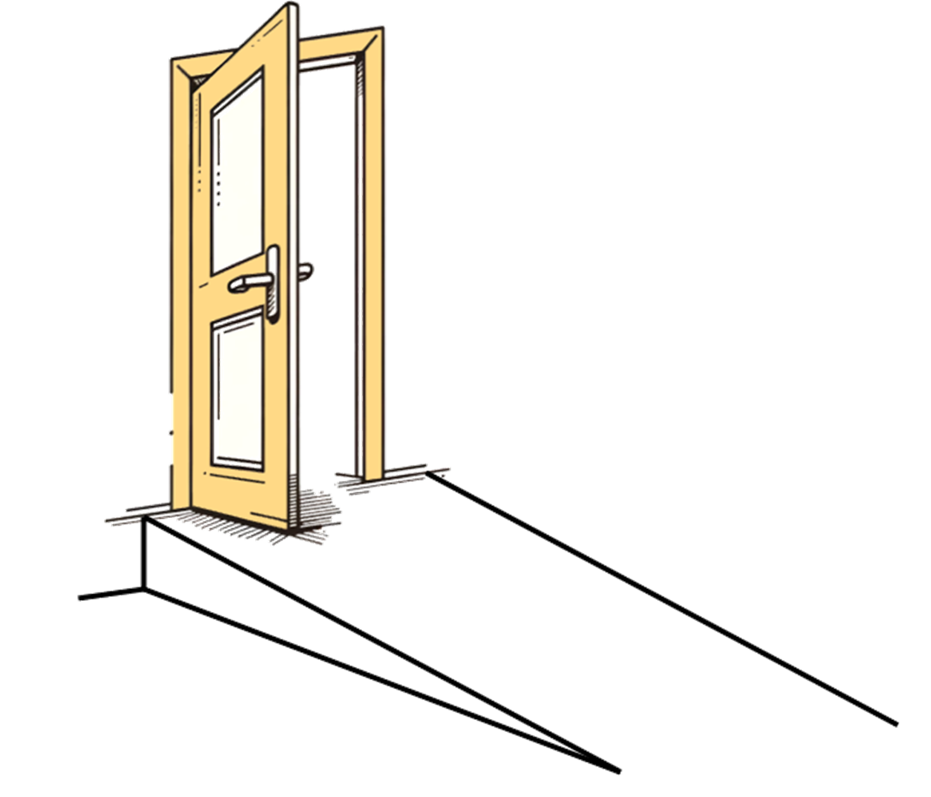
Practical uses of trigonometry
A ramp needs to be built outside a different shop for wheelchair access. The incline of the ramp still cannot exceed 4.8°. The bottom of this doorway is 30 cm high. How long is the ramp?
30
d =
= 358.51…
d cm
sin(4.8°)
30 cm
4.8°
The ramp is 3.59 metres long.

Slide 28

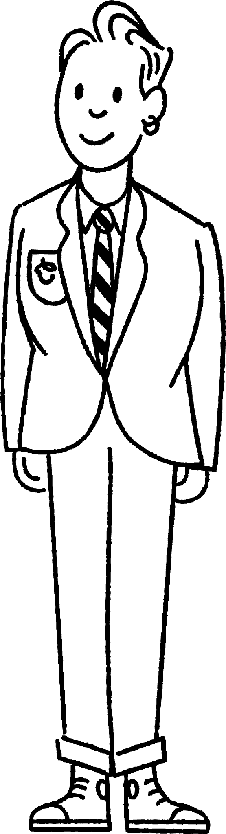
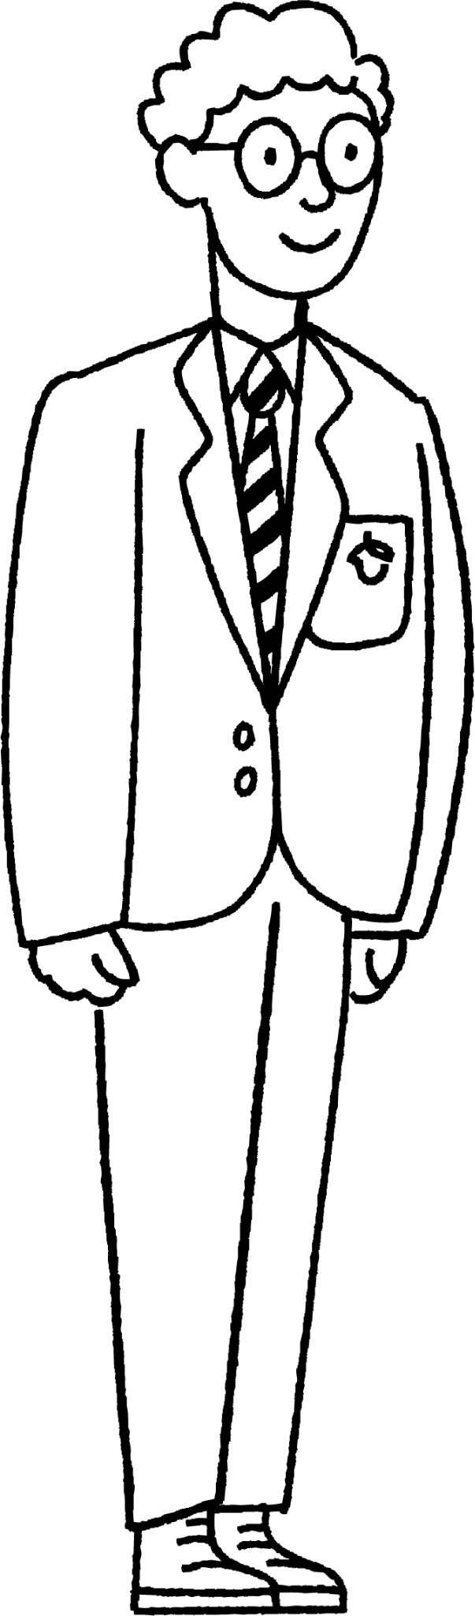
Practical uses of trigonometry
Alex and Sam are estimating the height of the traffic lights.
How could they do this by using trigonometry?
If we know Alex’s height and measure the angle to the top of the traffic lights from his eyeline, we can use trigonometry.
h m
52°
A tool called a clinometer can measure the angle.
156 cm
3 m

Slide 29
Practical uses of trigonometry
Alex and Sam are estimating the height of the traffic lights.
How could they do this by using trigonometry?
x = 3 × tan(52°) = 3.839…
x m
h = 3.83… + 1.56
= 5.4 (1 d.p.)
h m
52°
3 m
156 cm
3 m

Slide 30
Practical uses of trigonometry
Fill the blanks to estimate the height of this traffic light.
x = × tan(52°) = m
2
2.55…
x m
h = 2.55… + 1.56
= m
h m
52°
4.12
2 m
156 cm
2 m

Slide 31
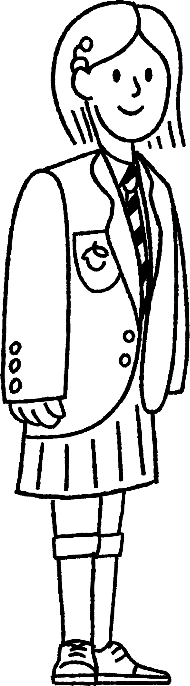
Practical uses of trigonometry
Sofia is standing on top of a cliff, 60 m above sea-level. She can see two buoys straight in front of her. The angles of depression of these buoys are 47º and 32º respectively. Sofia wants to estimate how far apart the two buoys are from each other.
32°
15°
What does the 1.35 m represent?
The height of Sofia to her eyeline.
(60 + 1.35) m
d m

Slide 32
Practical uses of trigonometry
Sofia is standing on top of a cliff, 60 m above sea-level. She can see two buoys straight in front of her. The angles of depression of these buoys are 47º and 32º respectively. Sofia wants to estimate how far apart the two buoys are from each other.
32°
A simplified version of this diagram will be useful here.
15°
(60 + 1.35) m
d m

Slide 33
Practical uses of trigonometry
Sofia is standing on top of a cliff, 60 m above sea-level. She can see two buoys straight in front of her. The angles of depression of these buoys are 47º and 32º respectively. Sofia wants to estimate how far apart the two buoys are from each other.
x = 61.35 × tan((43 + 15)°) = 98.18
15°
y = 61.35 × tan(43°) = 57.21
58°
43°
61.35 m
x m
98.18 m
y m
d m
57.21 m

Slide 34
Practical uses of trigonometry
Sofia is standing on top of a cliff, 60 m above sea-level. She can see two buoys straight in front of her. The angles of depression of these buoys are 47º and 32º respectively. Sofia wants to estimate how far apart the two buoys are from each other.
x = 61.35 × tan((43 + 15)°) = 98.18
15°
y = 61.35 × tan(43°) = 57.21
43°
61.35 m
d = x - y = 98.18 - 57.21 = 40.97
The buoys are 40.97 m apart.
98.18 m
d m
57.21 m
40.97 m

Slide 35
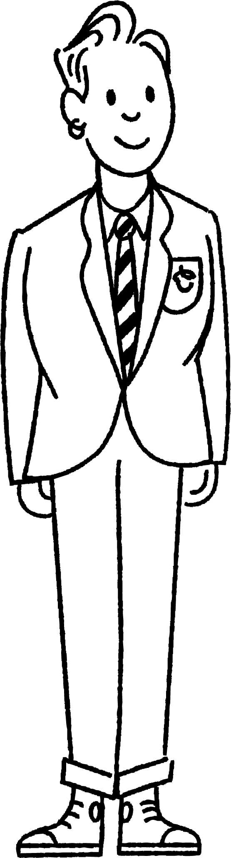
Practical uses of trigonometry
Sam is stood on top of a cliff, 60 m above sea-level. They can see two buoys straight in front of them. The angles of depression of these buoys are 46º and 32º respectively.
32°
x°
14°
What is the size of x?
46 - 32 = 14

Slide 36

Practical uses of trigonometry
They want to calculate the distance, d m, between the two buoys.
Which pair of triangles will they use in their calculations?
32°
14°
d m
14°
32°
31°
46°
44°
58°
a
b
c

Slide 37
Practical uses of trigonometry
The cliff is 60 m high and it is 1.63 m to Sam’s eye line.
44°
58°
distance to first buoy, x m
Complete the calculation to find the horizontal distance to the nearest buoy.
x = 61.63 × tan(44°) = 59.52 m (2dp)

Slide 38
Practical uses of trigonometry
The distance to the first buoy is 59.515.. m and the distance to the second buoy is 98.628… m.
44°
58°
59.515… m
98.628… m
What is the distance between the two buoys, to the nearest metre?
d = 98.628… - 59.515… = 39 m

Slide 39
Practical uses of trigonometry
1) A ramp is being built outside a house. The bottom of the door is 42 cm off the floor. The angle between the ramp and the ground should not exceed 4.8° What is the minimum slope length of the ramp?
2) A man standing on a river-bank notes a particular tree on the opposite bank. He then walks 60 metres along the river-bank in a straight line. On looking back he can see that the angle between the line of his path and a line to the tree is 32º. How wide is the river?

Slide 40
Practical uses of trigonometry
3) A 7 metre pole is secured by support wires. The wires are pegged in a straight line. The outer wires make an angle of 31° with the floor and the inner wires make an angle twice the size. How far apart are the wires?
7 m
31°
d m

Slide 41
Practical uses of trigonometry
1) A ramp is being built outside a house. The bottom of the door is 42 cm off the floor. The angle between the ramp and the ground should not exceed 4.8° What is the minimum slope length of the ramp?
m cm
42 cm
4.8°
42
m = = 501.9
sin(4.8°)
The slope is a minimum of 501.9 cm or 5.02 m long.

Slide 42
Practical uses of trigonometry
2) A man standing on a river-bank notes a particular tree on the opposite bank. He then walks 60 metres along the river-bank in a straight line. On looking back he can see that the angle between the line of his path and a line to the tree is 32º. How wide is the river?
r = 60 × tan(32°)
r m
r = 37.5
32°
The river is 37.5 metres wide.
60 m

Slide 43
Practical uses of trigonometry
3) A 7 metre pole is secured by support wires. The wires are pegged in a straight line. The outer wires make an angle of 31° with the floor and the inner wires make an angle twice the size. How far apart are the wires?
7 m
7 m
31°
31°
d m
7
tan(31°)
= 11.65 m
7 m
d = 11.65 - 3.72 = 7.93
7
62°
tan(62°)
= 3.72 m
The wires are 7.93 m apart.

Slide 44
Choosing an appropriate method for finding lengths of a triangle
Trigonometry can be used in many practical situations. Often it is used alongside Pythagoras’ theorem.
It is used to calculate or estimate the height of large objects, where measuring them is impractical.

Slide 45

© Oak National Academy 2024.
Produced in partnership with Mathematics in Education and Industry.
Licensed on the Open Government Licence v3.0, except where otherwise stated. See Oak terms and conditions.

